Slide 1
UNIT TESTING
CS4036
Lecture #4
Software Testing

Slide 2
Concept of Unit Testing
Unit-Module
all possible—or as much as possible—distinct executions are to be considered during unit testing
A programmer will need to verify whether or not a code works correctly by performing unit-level testing. Intuitively, a programmer needs to test a unit as follows:
• Execute every line of code. This is desirable because the programmer needs to know what happens when a line of code is executed. In the absence of such basic observations, surprises at a later stage can be expensive.
• Execute every predicate in the unit to evaluate them to true and false separately.
• Observe that the unit performs its intended function and ensure that it contains no known errors.

Slide 3
Concept of Unit Testing
Not everything pertinent to a unit can be tested in isolation because of the limitations of testing in isolation.
The source code of a unit is not used for interfacing by other group members until the programmer completes unit testing and checks in the unit to the version control system.

Slide 4
Concept of Unit Testing
Static Unit Testing
Code is examined over all possible behaviors that might arise during run time
Code of each unit is validated against requirements of the unit by reviewing the code
Dynamic Unit Testing
A program unit is actually executed and its outcomes are observed
One observe some representative program behavior, and reach conclusion about the quality of the system
Static unit testing is not an alternative to dynamic unit testing
Static and Dynamic analysis are complementary in nature
In practice, partial dynamic unit testing is performed concurrently with static unit testing
It is recommended that static unit testing be performed prior to the dynamic unit testing
Notes:
The Analogy: Static testing is like a doctor looking at an X-ray (checking structure); Dynamic testing is like a stress test on a treadmill (checking function). You need both to confirm the patient is healthy.
Runtime Realities: Static testing cannot detect errors that only appear during execution, such as memory leaks, pointer errors, or concurrency issues (race conditions).

Slide 5
Static Unit Testing
In static unit testing code is reviewed by applying techniques:
Inspection: It is a step by step peer group review of a work product, with each step checked against pre-determined criteria
Walkthrough: It is review where the author leads the team through a manual or simulated executed of the product using pre-defined scenarios
The idea here is to examine source code in detail in a systematic manner
The objective of code review is to review the code, and not to evaluate the author of the code
Code review must be planned and managed in a professional manner
The key to the success of code is to divide and conquer
An examiner inspect small parts of the unit in isolation
nothing is overlooked
the correctness of all examined parts of the module implies the correctness of the whole module

Slide 6
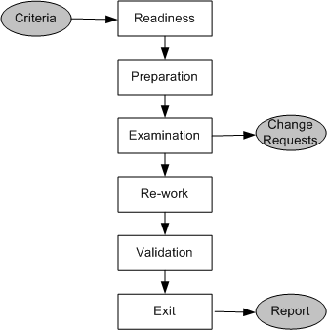
Static Unit Testing (Code Review)
Step 1: Readiness
Criteria
Completeness
Minimal functionality
Readability
Complexity
Requirements and design documents
Roles
Moderator
Author
Presenter
Record keeper
Reviewers
Observer
Reviewing is not reporting
Step 2: Preparation
List of questions
Potential Change Request (CR) – Not defects
Suggested improvement opportunities
Figure 3.1: Steps in the code review process
Notes:
Potential CR: A reviewer may make a formal request to make a change. These are called change requests rather than defect reports. At this stage, since the programmer has not yet made the code pub lic, it is more appropriate to make suggestions to the author to make changes, rather than report a defect. Though CRs focus on defects in the code, these reports are not included in defect statistics related to the product.

Slide 7
Static Unit Testing (Code Review)
Step 3: Examination
The author makes a presentation
The presenter reads the code
The record keeper documents the CR
Moderator ensures the review is on track
Step 4: Re-work
Make the list of all the CRs
Make a list of improvements
Record the minutes meeting
Author works on the CRs to fix the issue
Step 5: Validation
CRs are independently validated
Step 6: Exit
A summary report of the meeting minutes is distributes
A Change Request (CR) includes the following details:
Give a brief description of the issue
Assign a priority level (major or minor) to a CR
Assign a person to follow it up
Set a deadline for addressing a CR
Notes:
• The author makes a presentation of the procedural logic used in the code, the paths denoting major computations, and the dependency of the unit under review on other units.
• The presenter reads the code line by line. The reviewers may raise questions if the code is seen to have defects. However, problems are not resolved in the meeting. The reviewers may make general suggestions on how to fix the defects, but it is up to the author of the code to take corrective measures after the meeting ends.
. Set a deadline for addressing a CR.
Validation The CRs are independently validated by the moderator or another person designated for this purpose. The validation process involves checking the modified code as documented in the CRs and ensuring that the suggested improvements have been implemented correctly. The revised and final version of the outcome of the review meeting is distributed to all the group members.
Exit Summarizing the review process, it is said to be complete if all of the following actions have been taken:
• Every line of code in the unit has been inspected.
• If too many defects are found in a module, the module is once again reviewed after corrections are applied by the author. As a rule of thumb, if more than 5% of the total lines of code are thought to be contentious, then a second review is scheduled.
• The author and the reviewers reach a consensus that when corrections have been applied the code will be potentially free of defects.
• All the CRs are documented and validated by the moderator or someone else. The author’s follow-up actions are documented.
• A summary report of the meeting including the CRs is distributed to all the members of the review group.

Slide 8
Static Unit Testing (Code Review)
The following metrics can be collected from a code review:
The number of lines of code (LOC) reviewed per hour
The number of CRs generated per thousand lines of code (KLOC)
The number of CRs generated per hour
The total number of hours spend on code review process
Notes:
Code Review Metrics It is important to collect measurement data pertinent to a review process, so that the review process can be evaluated, made visible to the upper management as a testing strategy, and improved to be more effective.
Moreover, collecting metrics during code review facilitates estimation of review time and resources for future projects.
Thus, code review is a viable testing strategy that can be effectively used to improve the quality of products at an early stage.

Slide 9
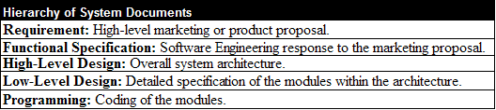
Static Unit Testing (Code Review)
The code review methodology can be applicable to review other documents
Five different types of system documents are generated by engineering department
Requirement
Functional Specification
High-level Design
Low-level Design
code
In addition installation, user, and trouble shooting guides are developed by technical documentation group

Slide 10
DEFECTPREVENTION
It is in the best interest of the programmers in particular and the company in general to reduce the number of CRs generated during code review.
This is because CRs are indications of potential problems in the code, and those problems must be resolved before different program units are integrated.
Addressing CRs means spending more resources and potentially delaying the project.
Therefore, it is essential to adopt the concept of defect prevention during code development.

Slide 11
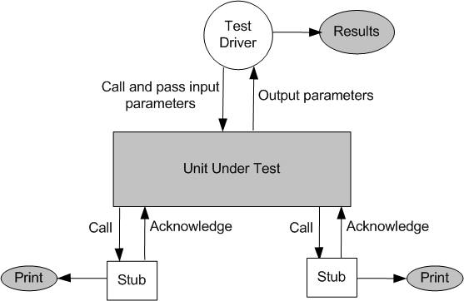
Dynamic Unit Testing
The environment of a unit is emulated and tested in isolation
The caller unit is known as test driver
A test driver is a program that invokes the unit under test (UUT)
It provides input data to unit under test and report the test result
The emulation of the units called by the UUT are called stubs
It is a dummy program
The test driver and the stubs are together called scaffolding
The low-level design document provides guidance for selection of input test data
Figure 3.2: Dynamic unit test environment
Notes:
The test driver should have the capability to automatically determine the success or failure of the unit under test for each input test data.
If appropriate, the driver should also check for memory leaks and problems in allocation and deallocation of memory. If the module opens and closes files, the test driver should check that these files are left in the expected open or closed state after each test.
The test driver can be designed to check the data values of the internal variable that normally would not be available for checking at integration, system, or acceptance testing levels.

Slide 12
Dynamic Unit Testing
Selection of test data is broadly based on the following techniques:
Control flow testing
Draw a control flow graph (CFG) from a program unit
Select a few control flow testing criteria
Identify a path in the CFG to satisfy the selection criteria
Derive the path predicate expression from the selection paths
By solving the path predicate expression for a path, one can generate the data
Data flow testing
Draw a data flow graph (DFG) from a program unit and then follow the procedure described in control flow testing.
Domain testing
Domain errors are defined and then test data are selected to catch those faults
Functional program testing
Input/output domains are defined to compute the input values that will cause the unit to produce expected output values
Notes:
A domain error occurs when a specific input data causes the program to execute a wrong, that is, undesired, path in the program.

Slide 13
Mutation Testing: A mutation of a program is a modification of the program created by introducing a single, small, legal syntactic change in the code. A modified program so obtained is called a mutant.
Debugging:
Brut Force
Cause elimination
Backtracking

Slide 14
Mutation Testing
Mutation testing is often called "Testing the Testers." While most testing techniques look for bugs in your code, mutation testing looks for "bugs" (weaknesses) in your test cases.
Mutation testing is not a testing strategy like control flow or data flow testing. It should be used to supplement traditional unit testing techniques.
A mutation of a program is a modification of the program created by introducing a single, small, legal syntactic change in the code.
A modified program so obtained is called a mutant.

Slide 15
Mutation Testing: Workflow
Phase 1: The Healthy Baseline
You start with your original, correct code and a set of test cases that all pass.
Code: if (x > 0) return true;
Test: assert(isPositive(5) == true); (Status: PASS)
Phase 2: Creating the "Zombies" (Mutants)
A mutation tool automatically creates multiple versions of your code, each with exactly one small change (a "mutation"). Each version is called a Mutant.
Mutant 1: if (x >= 0) return true; (Relational operator change)
Mutant 2: if (x < 0) return true; (Logic reversal)
Mutant 3: if (x > 1) return true; (Value change)

Slide 16
Mutation Testing: Workflow
Phase 3: The Battle
You run your original test cases against every single mutant.
Phase 4: The Outcomes
Killed (Caught): If a test fails when running against a mutant, the mutant is "killed." This is good! It means your test was strong enough to notice the change.
Survived (Lived): If all your tests still pass despite the code change, the mutant "survived." This is bad. it means your tests are weak and missed a potential bug.

Slide 17
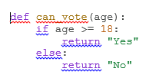
Mutation Testing: Programming Example
Your Current Test Suite:
Test A: can_vote(20) → Expected: "Yes"
Test B: can_vote(10) → Expected: "No"
The Mutation Attack:
The tool creates a mutant by changing the boundary operator:
Mutant 1: if age > 18: (Changed >= to >)
Running the Tests against Mutant 1:
Test A (20): Result is "Yes". (Expected "Yes"). Passed.
Test B (10): Result is "No". (Expected "No"). Passed.
The Result: The Mutant Survived. Your tests didn't notice that an 18-year-old would now be told "No" instead of "Yes."
The Solution: You must add a new test case: can_vote(18). This test would fail on the mutant, thus "killing" it and making your suite stronger.
.

Slide 18

Mutation Testing:
The Mutation Score
At the end, you calculate a score to see how effective your testing is:
Goal: A score as close to 100% as possible.
The "Equivalent Mutant" Problem
Sometimes a tool creates a mutant that is logically identical to the original code, even if it looks different.
Original: for (i=0; i < 10; i++)
Mutant: for (i=0; i != 10; i++)
Since they behave exactly the same, no test can ever kill this mutant. These are called Equivalent Mutants and are usually filtered out manually by the tester.
.

Slide 19
Mutation Testing:
Why do it? To find "blind spots" in your test suite.
The Catch: It is computationally very expensive (running thousands of tests against thousands of versions of code).
Connection to RIPR: Mutation testing forces Infection (changing the code) and Propagation, then checks if your test provides Revealability.
.

Slide 20
UNITTESTING IN EXTREME PROGRAMMING
A TDD approach to code development is used in the XP methodology.
The key aspect of the TDD approach is that a programmer writes low-level tests before writing production code.
This is referred to as test first in software development.
In XP, a few unit tests are coded first, then a simple, partial system is implemented to pass the tests.
Then, one more new unit test is created, and additional code is written to pass the new test, but not more, until a new unit test is created.
The process is continued until nothing is left to test.
.

Slide 21
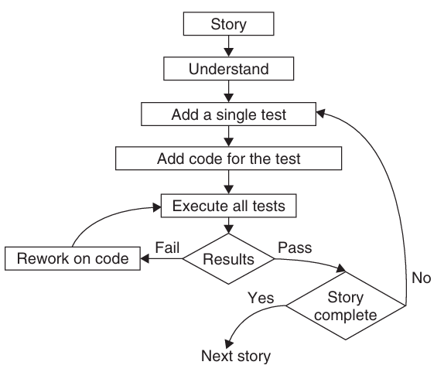
UNITTESTINGINEXTREMEPROGRAMMING
.

Slide 22
UNITTESTINGINEXTREMEPROGRAMMING
A TDD developer must follow the three laws proposed
• One may not write production code unless the first failing unit test is written.
• One may not write more of a unit test than is sufficient to fail. • One may not write more production code than is sufficient to make the failing unit test pass.
Creating unit tests helps a developer focus on what needs to be done.
Requirements, that is, user stories, are nailed down firmly by unit tests.
Unit tests are released into the code repository along with the code they test.

Slide 23
UNITTESTINGINEXTREMEPROGRAMMING
Unit tests provide a safety net of regression tests and validation tests so that XP programmers can refactor and integrate effectively.
In Extreme Programming (XP), code is constantly changing. We refactor (clean up) code daily and integrate our work into the main build every few hours. Without a "safety net," this would be a recipe for disaster.
This statement means that your suite of unit tests acts like a 24/7 automated security guard. If you change a line of code and something—anything—goes wrong, a test will fail immediately.
This gives you the courage to improve the code without the fear of accidentally "breaking the world."

Slide 24
UNITTESTING IN EXTREME PROGRAMMING
Element | Role in XP
Validation | Proves the code does what the user asked for right now.
Regression | Proves that today's "cleanup" didn't break yesterday's "feature."
Refactoring | Possible only when you have tests to catch your "accidental" mistakes.
Integration | Possible only when you can prove your code doesn't break your neighbor's code.

Slide 25
EXTREME Programming
Extreme Programming (XP) is one of the foundational frameworks of the Agile movement.
When the Agile Manifesto was written in 2001, Kent Beck (the creator of XP) was one of the 17 original signatories.
Scrum provides the "managerial" framework for Agile, XP provides the "engineering" heart of it.

Slide 26
EXTREME Programming
How XP directly implements the four values of the Agile Manifesto:
1. Individuals and Interactions over Processes and Tools
•XP Practice: Pair Programming and Collective Ownership.
•The Logic: Instead of relying on a rigid ticketing system or complex documentation tools, XP mandates that two people sit together and talk through the code. It prioritizes the human interaction of "working together" to solve problems over the "process" of solo coding.
2. Working Software over Comprehensive Documentation
•XP Practice: Test-Driven Development (TDD) and Small Releases.
•The Logic: In XP, the "documentation" is often the test suite itself. Because the team releases small updates every week or two, the focus is always on having a functional, "working" system rather than a 200-page manual describing a system that hasn't been built yet.

Slide 27
EXTREME Programming
How XP directly implements the four values of the Agile Manifesto:
3. Customer Collaboration over Contract Negotiation
•XP Practice: On-site Customer.
•The Logic: XP requires a customer representative to be physically present (or digitally available at all times) with the team. They don't just sign a contract and leave; they collaborate daily, defining user stories and validating features as they are finished.
4. Responding to Change over Following a Plan
•XP Practice: Refactoring and Simplicity.
•The Logic: XP assumes the plan will change. By keeping the code simple and constantly "refactoring" (cleaning it up), the software remains flexible. The team doesn't fear change; they embrace it because their technical practices (like TDD) make it safe to change the code at any time.

Slide 28
EXTREME Programming
"Is XP the same as Scrum?" The distinction:
•Scrum is about Product Management: It defines roles (Scrum Master, Product Owner), ceremonies (Sprints, Daily Standups), and artifacts (Backlog).
•XP is about Software Engineering: It defines how you actually write the code (TDD, Pair Programming, CI, Refactoring).
Most successful Agile teams actually do "Scrum-XP"—they use Scrum to manage the project and XP practices to ensure the code doesn't turn into a "big ball of mud."

